Slide 1
J K K NATTRAJA COLLEGE OF ENGINEERING AND TECHNOLOGY
TEAM MEMBERS:
JAE DIVYA S
MADHUMITHA R
GOMATHI K
SATHYA DEVI P
MENTOR:
MURUGASHANKAR S

Slide 2
Design and Innovation Proposal:
Product Demand Prediction with Machine Learning.
ABSTRACTION
predicting product demand is a crucial task for businesses to optimize their inventory and supply chain management. machine learning provides a powerful tool to analyze historical sales data and predict future demand with high accuracy. this guide will provide a comprehensive overview of the process and techniques involved in product demand prediction with machine learning.

Slide 3
Problem Statement:
Accurately predicting product demand is crucial for businesses to optimize inventory management, production planning, and supply chain operations. traditional forecasting methods often struggle to capture the complex relationships and dynamic patterns in demand data. there is a need for an innovative machine learning solution that can leverage advanced techniques to provide accurate and actionable demand predictions.

Slide 4
Description:
Product demand prediction with machine learning uses historical data and advanced algorithms to forecast future product demand accurately. It helps optimize inventory, improve sales, reduce costs, and gain a competitive edge through informed decision-making. By integrating these predictions into business operations, companies can enhance customer service and increase overall efficiency.

Slide 5
Objectives:
The primary objectives of product demand prediction with machine learning are to:
Accurately forecast future demand for products.
Optimize inventory management and production planning.
Enhance customer service by ensuring product availability.
Improve overall business efficiency and profitability through data-driven decision-making.

Slide 6
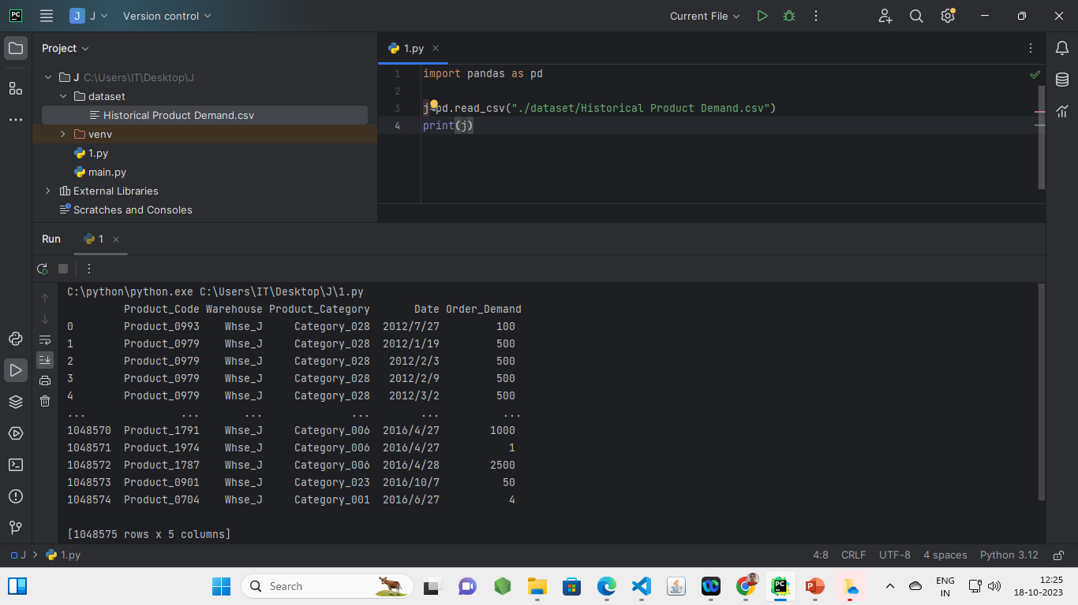
PROGRAMMING CODE BEFORE PREPROCESSING.

Slide 7
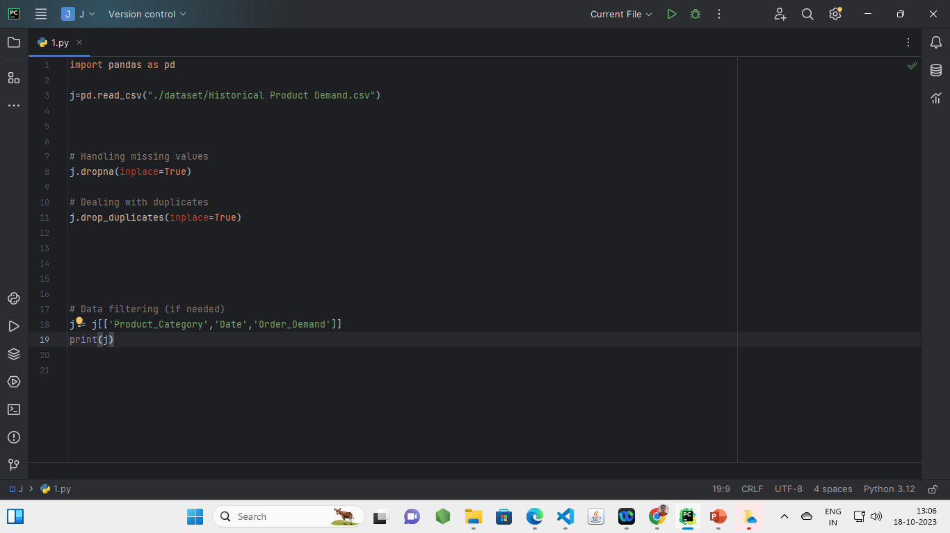
PROGRAMMING CODE AFTER LOADING AND PREPROCESSING.

Slide 8
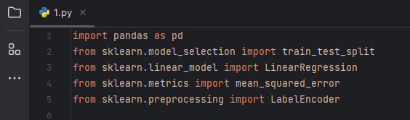
IMPORTING TEST PACKAGE

Slide 9
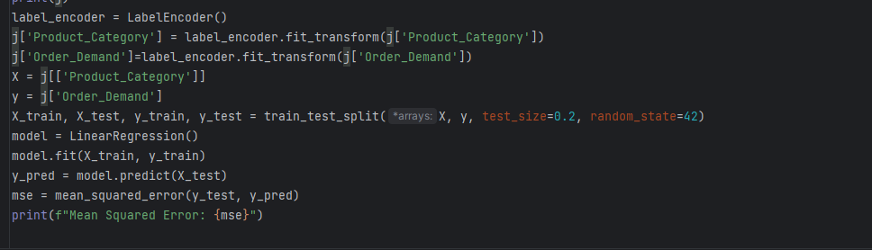
CODE:

Slide 10
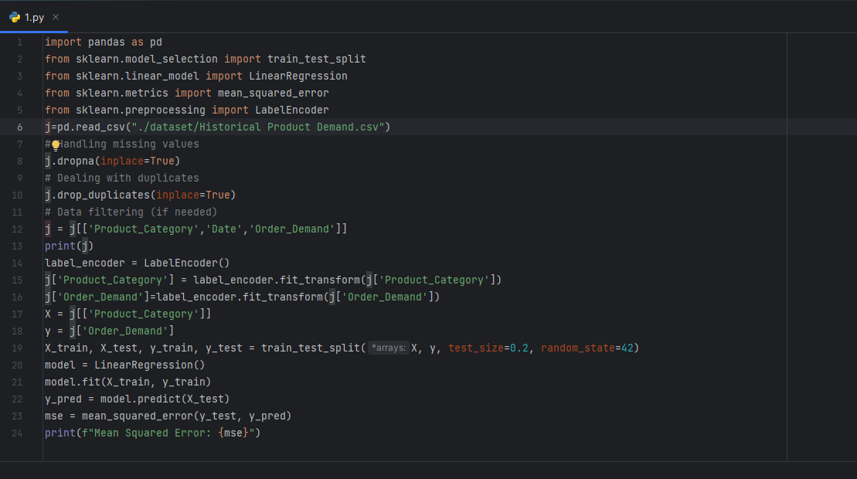
ENTIRE CODE FOR THE PROJECT

Slide 11
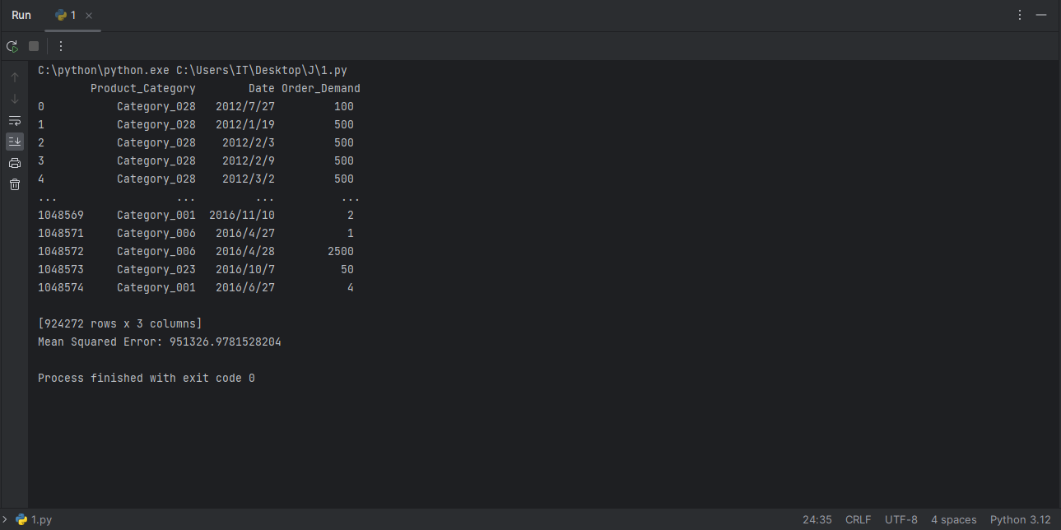
OUTPUT

Slide 12
SOURCE:
Product demand prediction with machine learning with the use of Kaggle.
USED SOFTWARE FOR PROGRAMMING:
pycharm with installed pandas.

Slide 13
Help:
GITHUB LINK
GITHUB
For more information refer readme file
Readme

Slide 14
Thank you…

